Slide 1
Presentation
30.09.2026

Slide 2

Content of the CAMARA presentation
#3 CAMARA Mission
#4-#7 CAMARA Motivation – Key problems we try to solve
#8-#15 CAMARA Scope, Collaboration with Open Gateway and TM Forum, API Distribution Options
#16 What is different now in comparison to former API exposure trials?
#17-#19 History, Logos & Current Figures – Where we started and where we are now
#20-#28 Current Meta Release, CAMARA APIs, Showcases, Public Launch Status
#29-#32 5G network capabilities, Potential Business Use Cases
#33-#39 The API ecosystem – Current status and challenges / Prepare for Agentic AI
#40-#44 Benefit for developers to use CAMARA APIs & Getting Started
#45-#49 Benefit for developers to work in CAMARA & Joining CAMARA as Developer
#50-#52 Benefit for operators to implement CAMARA APIs in their networks & Getting Started
#53-#59 Benefit for operators to work in CAMARA & Getting Started
#60-#61 Where are we going next, Contacts

Slide 3
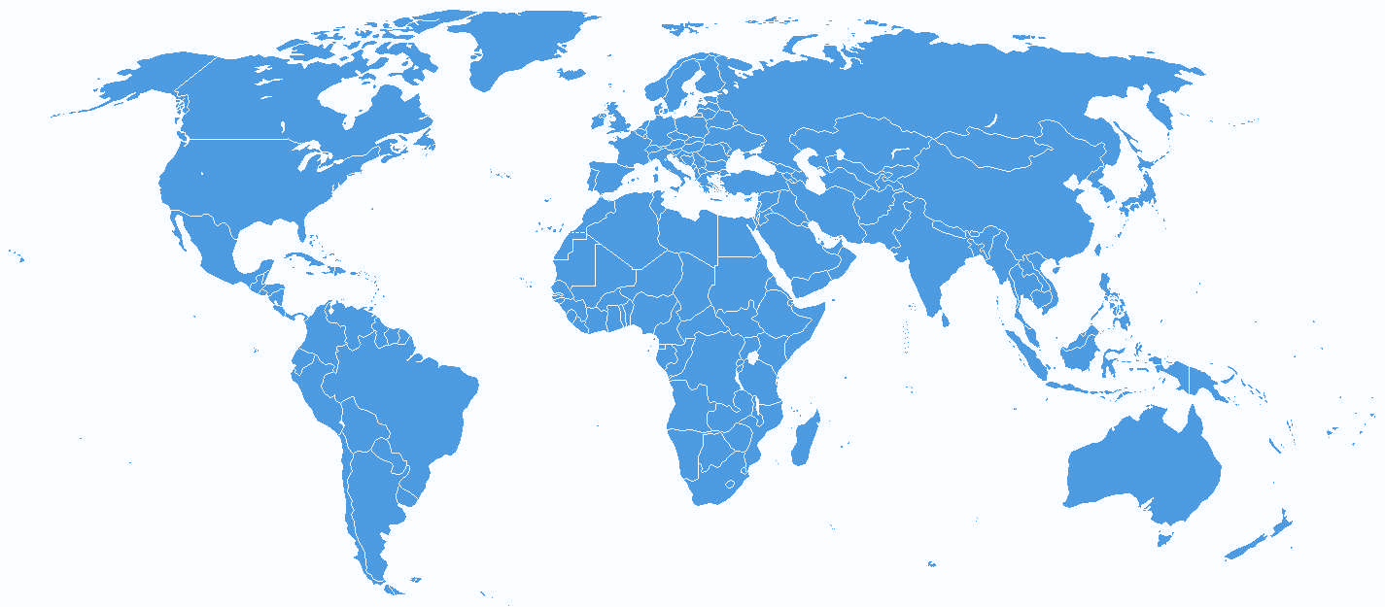

APIs enabling seamless access to
Telco network capabilities
Telco network capabilities exposed through APIs provide a large benefit for customers. By simplifying telco network complexity with APIs and making the APIs available across telco networks and countries, CAMARA enables easy and seamless access.
CAMARA Mission

Slide 4





What is the CAMARA Project?
Key problems we try to solve
Scale
Developers dream of being the next unicorn… If apps, products, or services are built on our APIs they want them in all relevant markets and networks globally.
Consistency
Multi-nationals want consistency across all markets they operate in… they do not want APIs that only work in a single network in a single country. They do not want to try and build for the differences of each network.
Simplicity
Telco networks are complex, and every network is different…. Developers want simple, intent-based APIs.
Accessibility
We go to the developers where they are so the project is open sourced in the Linux Foundation. Allowing API users to work directly with CSPs creating the service.
Demand Driven
We develop the APIs and design it in the way our customers need it. The demand is collected from organizations like GSMA OPAG but also from customers directly.

Slide 5
Key problems we try to solve
Consistency Benefit
Availability across telco networks and countries is necessary:
To ensure seamless customer experience
To accelerate technology development and commercial adoption (minimize implementation effort)
To accelerate education and promotion
To support application portability

Slide 6
Key problems we try to solve
Simplicity Benefit
Abstraction by transformation from network capabilities to Service APIs is necessary:
To simplify telco complexity making APIs easy to consume for customers with no telco expertise (user-friendly APIs)
To satisfy data privacy and regulatory requirements
To facilitate application to network integration
Service API
Transformation Function
Mobile
NT
Fixed Line
NT
IT
Other
Southbound capabilities

Slide 7


CAMARA
Open Source
CAMARA is an open source project within Linux Foundation to define, develop and test the APIs. CAMARA works in close collaboration with the GSMA Operator Platform Group to align API requirements and publish API definitions. Harmonization of APIs is achieved through fast and agile created working code with developer-friendly documentation. API definitions and reference implementations are free to use (Apache2.0 license).

Slide 8



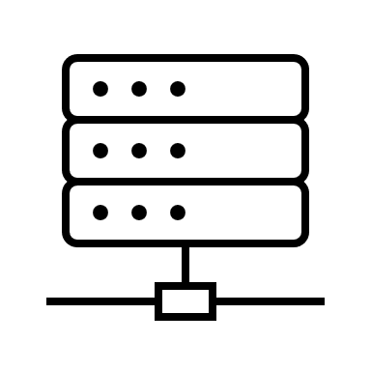
CAMARA
Scope
Application
From functional perspective the scope is limited to telco APIs, that means APIs in the domain of telco mobile networks, telco fixed line networks, telco edge cloud, etc. or supporting these.
Thereby the focus is on the northbound interface (between telco operator and aggregator or capability consumer). East-/westbound interface APIs are out of scope for CAMARA.
N
Service APIs
Exposure Gateway
E/W
Transformation Function
S
Network capabilities
S
Network/IT/ Other
Operator 1
Operator 2

Slide 9
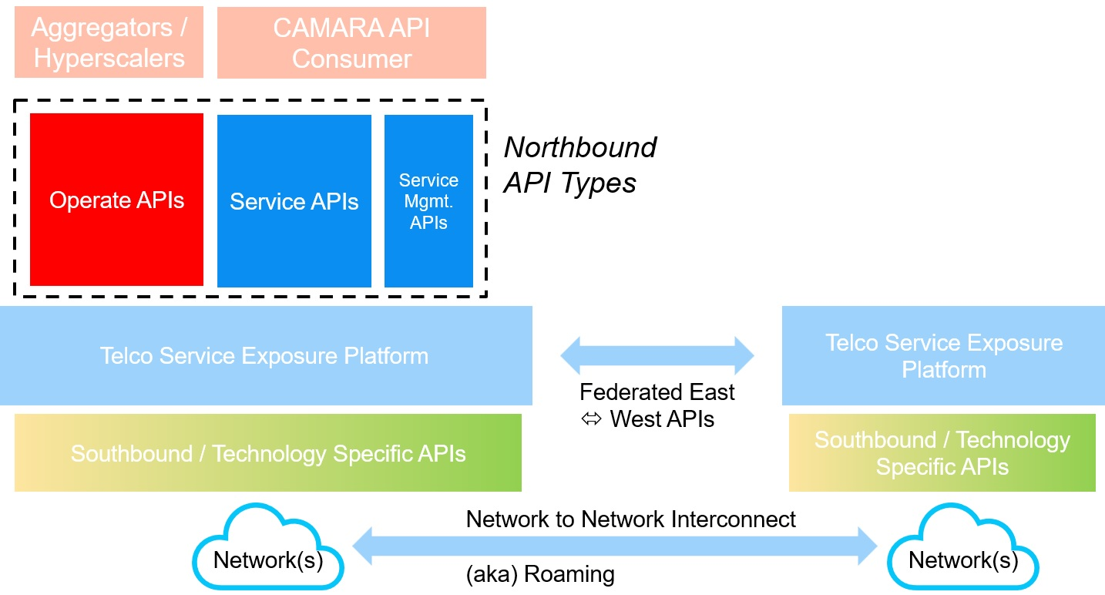
CAMARA
Scope
We differentiate between 3 types of Northbound APIs:
Service APIs: APIs intended for end consumers and integrated by developers to invoke a certain telco capability.
Service Management APIs: APIs intended for end consumers to manage or get data about offered Service APIs in application runtime, e.g., check service availability or performance information.
Operate APIs: Operational and maintenance APIs provided by a telco to channel partners for the purpose of service fulfillment and assurance to their [channel partner] customers. This may include service provisioning for a mobile user, technical API performance monitoring, fault ticketing, information exchange such as product catalog, pricing, settlement, etc.
Service APIs and Service Management APIs are in scope of CAMARA. Operate APIs are out of scope of CAMARA (these are already covered by other SDOs = Standards Development Organizations like TM Forum).

Slide 10
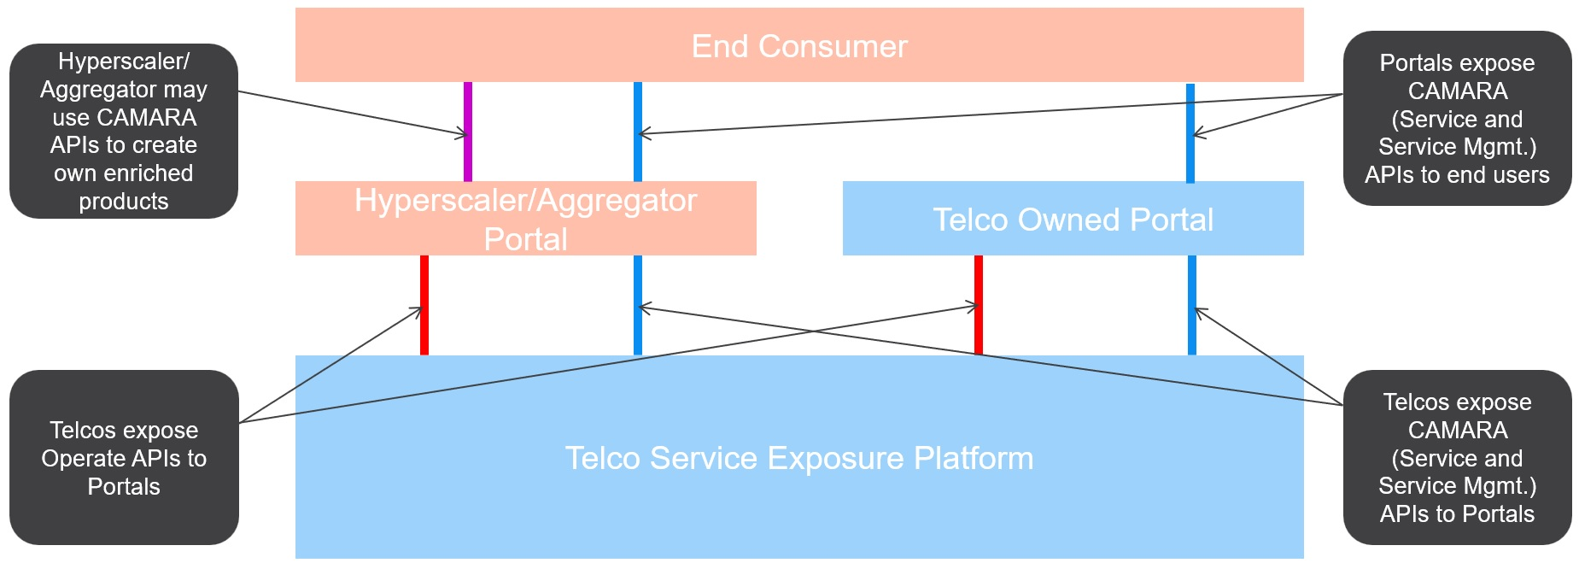
CAMARA – Scope / Collaboration with
Open Gateway and TM Forum
Hyperscalers and aggregators have the possibility to create own enriched products based on the CAMARA APIs and expose that in addition to the CAMARA APIs.

Slide 11
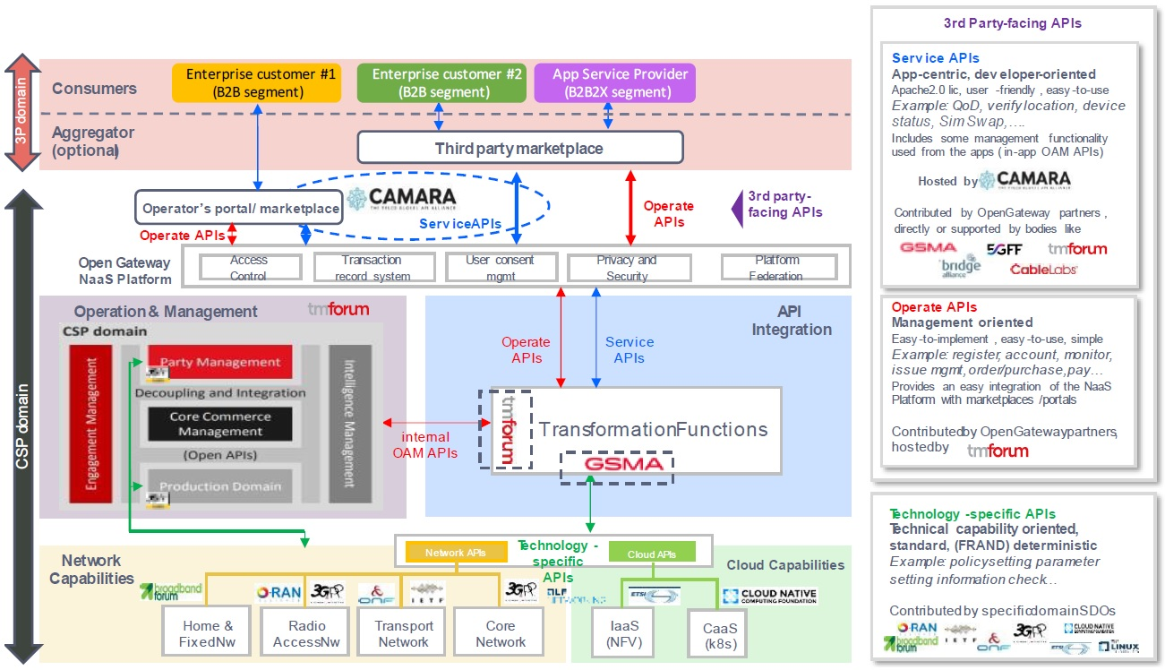
CAMARA – Scope / Collaboration with
Open Gateway and TM Forum
CAMARA project defines
CAMARA APIs.
TMForum develops the Operate APIs.
Several SDOs cover the different technology domains that provide the telco capabilities.
More details can be found in the whitepaper “The Ecosystem for Open Gateway NaaS API Development” (jointly published by GSMA, CAMARA, Linux Foundation and TMForum) available here.

Slide 12




CAMARA – Scope / Collaboration with
Open Gateway and TM Forum
API definition
Collaboration Agreement
Technical standard for telco service exposure platform
Service API “standardization”
Standardization of telco service exposure platform
Drive API Adoption (customers/ developers and operators)
Developer Engagement
Business templates for Northbound and E/W
Playbooks
Open API Ecosystem
East-West Federation
Collaboration Agreement
Collaboration Agreement
Operate API definition
(catalogue and order management, on-/offboarding, billing)
Catalyst programs
Operate API standardization

Slide 13



Role of CAMARA, Open Gateway and aggregators
Customers / developers
Aggregators in each market
API Aggregation
Consent
Aggregation
Operator API Exposure
API Gateway
API Mgmt
Policy & Bookkeeping
Catalogue
Transformation
Consent
Identity
Monetization
Analytics
Party Mgmt
Internal API-Gateways
Cloud SIP
Numbering
NW APIs
(e.g., QoD)
IT (Billing)
APIs
Identity
APIs
Other 3rd-
party APIs
Network / Backend
Mobile Network Capabilities
Fixed Line Network Capabilities
Telco IT Capabilities
BSS

Slide 14

CAMARA
Scope
The scope of the CAMARA Project is:
Collect API requirements from GSMA Operator Platform Group and other sources
Define Service APIs and Service Management APIs
Create test plans / cases / tools from an API consumer perspective
Develop and test Service APIs and Service Management APIs
Create developer friendly documentation
The following deliverables are provided by the CAMARA Project:
Service API and Service Management API definitions and documentation
Optionally Service API and Service Management API code and
Test plans, cases and tools for the APIs all contained in deployment packages.
Project resources can be found in the GitHub repository: https://github.com/camaraproject.

Slide 15
CAMARA API
Distribution Options
Single-Operator Relationship
Multi-Operator Relationship
End Consumer
Blue lines =
CAMARA APIs
Red lines =
Operate APIs
SEP=
Service Exposure Platform
End Consumer
Portal 1
Aggregator
Portal 2
Portal 1
Aggregator
Portal 2
Telco SEP 1
Telco SEP 2
Telco SEP 1
Telco SEP 2
Operator Aggregation
Single-Operator “API Roaming”
End Consumer
End Consumer
Portal 1
Aggregator
Portal 2
Portal 1
Aggregator
Portal 2
Telco SEP 1
Telco SEP 2
Telco SEP 1
Telco SEP 2

Slide 16
What is different now in comparison to former API exposure trials?
Simplicity – Telco complexity is hidden behind simple, easy to use APIs
Demand driven - Listening to API consumer’s voice and demand
Availability – Open APIs with great support of many operators on many platforms
Alignment - With standardization bodies like TM Forum, GSMA or ETSI-MEC
Sustainability – We have the CEOs behind (e.g. Open Gateway MoU, API Venture)
Telco maturity – Telcos are now more digital and cloud oriented
Privacy – Well defined

Slide 17

















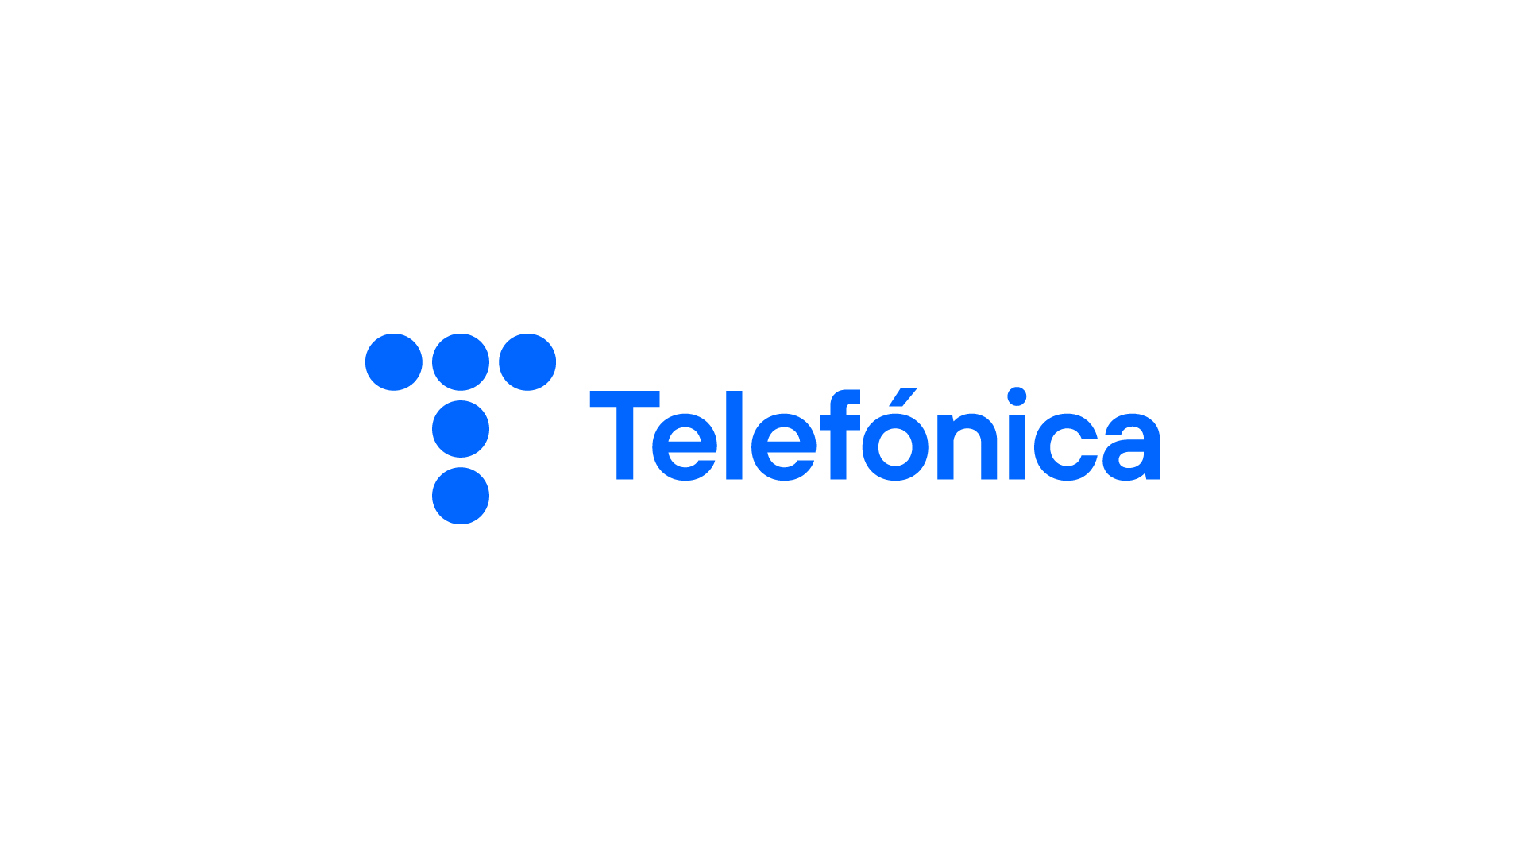



CAMARA
Where we started…
Launched at MWC Barcelona 2022
22 Launch Partners
Supported by GSMA and Linux Foundation
Simple idea to “standardize” developer facing APIs

Slide 18
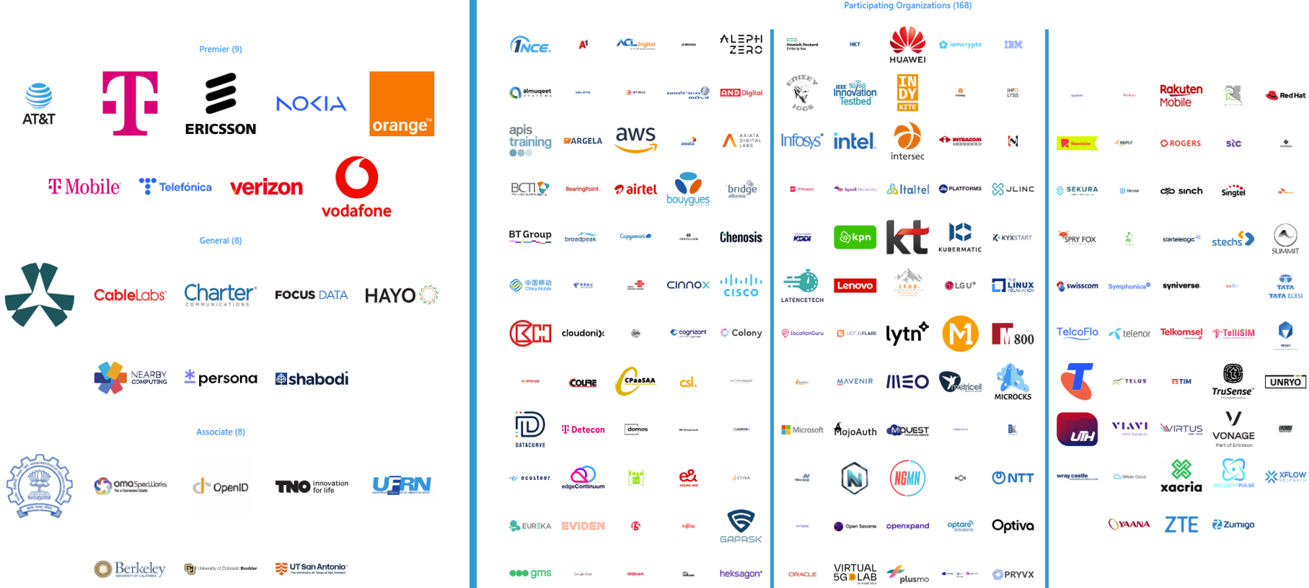
CAMARA
… and where we are now
195 Named Partners
490 companies participating in CAMARA
8 API Sub Projects
30 Sandbox Projects
72 APIs
5 Working Groups
1368 people joined CAMARA
Development ”home” for GSMA Open Gateway

Slide 19

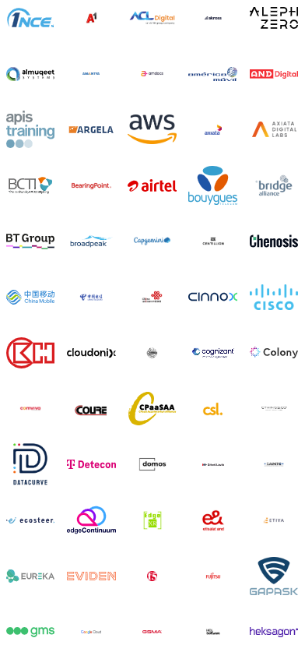
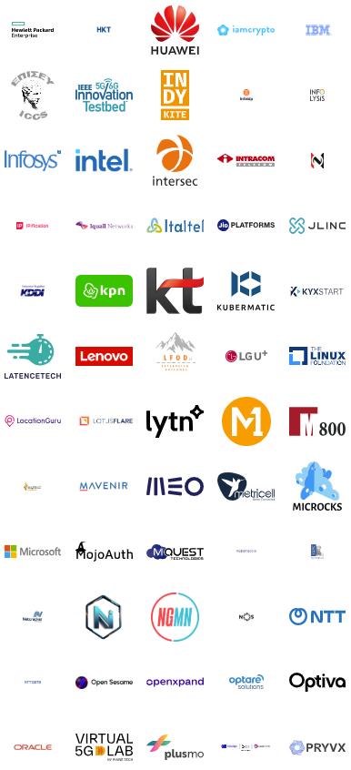
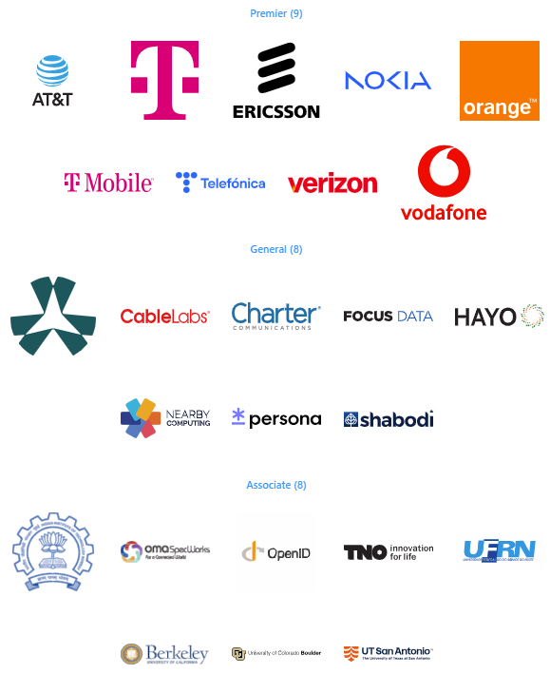
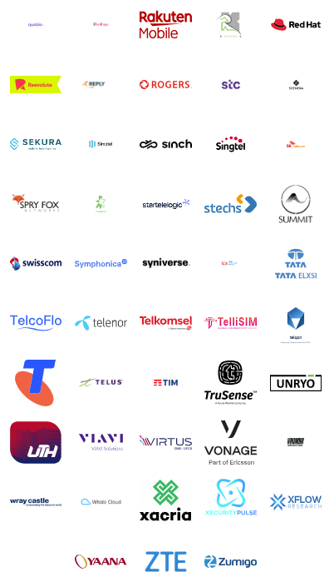
CAMARA
Logos

Slide 20
Release Management
Motivation and Benefits
A CAMARA meta-release combines a set of CAMARA API versions into a consistent release.
There are two meta-releases per year (in spring and fall).
    API providers (e.g. Network operators, Channel Partners) can plan their implementations and deployments in production.
    API consumers can plan the integration in their platform and applications.
All API versions in a meta-release fulfill defined quality criteria and are compliant to the CAMARA guidelines from CAMARA Commonalities and Identity and Consent Management of that meta-release.
CAMARA meta-releases ensure the
    Availability of consistent API definitions (by use of guidelines, templates, and linting),
    Quality of API definitions (by use of checklists, test definitions, and release management),
    Stability of API definitions (clear criteria for stable versus initial API versions) and
    Reliability of schedule and deliverables (with defined milestones and release candidates).
CAMARA meta-releases provide the foundation for API version management in production.

Slide 21
Release Management
Release Cycle
Operator production
deployments, certifications
& channel integrations
of CAMARA Spring meta-release
(Operator/Vendor)
Lab implementations
& tests of release
candidates (rc)
2 meta-releases per year
  Fall (in September)
  Spring (in March)
Continuous and overlapping cycles
  Update of CAMARA guidelines
  Development and updates of API definitions in CAMARA
  Lab implementations and production deployments at network operators
Tests of API release candidates
  In operator (lab) implementations
  Based on CAMARA test definitions
Feedback in all phases
  From (lab) implementations and deployments to CAMARA API definitions and guidelines
  From API definition work to
  CAMARA guidelines
CAMARA API
definitions
Alpha
RC
RC
Spring Meta-
release
CAMARA
Guidelines
& Templates
Fall Meta-
release
RC
RC
CAMARA API
definitions
Alpha
(Operator/Vendor)
Lab implementations
& tests of release
candidates (rc)
Operator production
deployments, certifications
& channel integrations
of CAMARA Fall meta-release
For details see: https://wiki.camaraproject.org/display/CAM/Meta-release+Process

Slide 22

CAMARA Fall 25 meta-release
60 #total CAMARA APIs
23
NEW INITIAL APIs (v0.y.z)
application-endpoint-discovery
application-endpoint-registration
blockchain-public-address-validation
brand-registration
consent-info
dedicated-network
dedicated-network-accesses
dedicated-network-profiles
device-data-volume
device-data-volume-subscriptions
energy-footprint-notification
knowledge-base
most-frequent-location
network-slice-booking
optimal-edge-discovery
predictive-connectivity-data
qa-assistant-manage
qa-assistant-service
qos-booking
qos-booking-and-assignment
subscription-status
traffic-influence
verified-caller
10
STABLE APIs
device-reachability-status
device-roaming-status
device-swap
location-verification
number-verification
one-time-password-sms
qos-profiles
quality-on-demand
sim-swap
simple-edge-discovery
27
SPRING25 UPDATED INITIAL APIs (v0.y.z)
application-profiles
blockchain-public-address
call-forwarding-signal
carrier-billing
carrier-billing-refund
connected-network-type
connected-network-type-subscriptions
connectivity-insights
connectivity-insights-subscriptions
customer-insights
device-identifier
device-reachability-status-subscriptions
device-roaming-status-subscriptions
geofencing-subscriptions
kyc-age-verification
kyc-fill-in
kyc-match
kyc-tenure
location-retrieval
number-recycling
population-density-data
qos-provisioning
region-device-count
sim-swap-subscriptions
webrtc-call-handling
webrtc-events
webrtc-registration

Slide 23
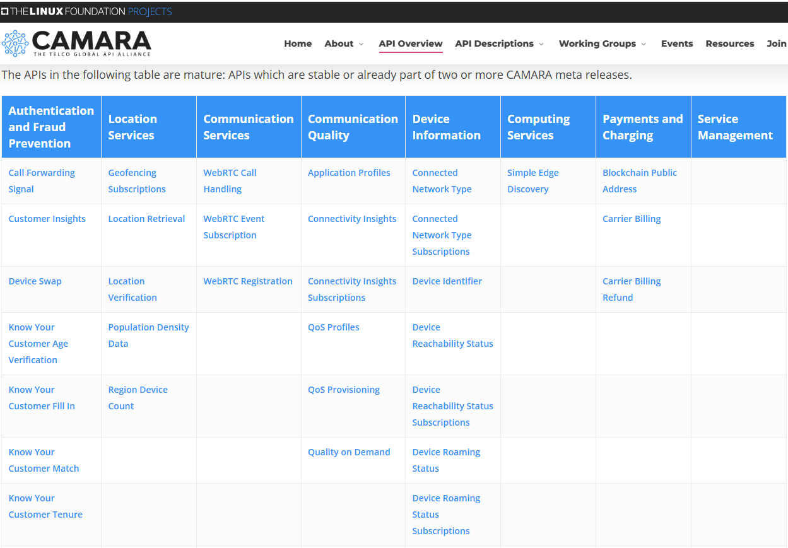
CAMARA API Overview
https://camaraproject.org/api-overview/
Mature APIs
APIs in earlier development

Slide 24
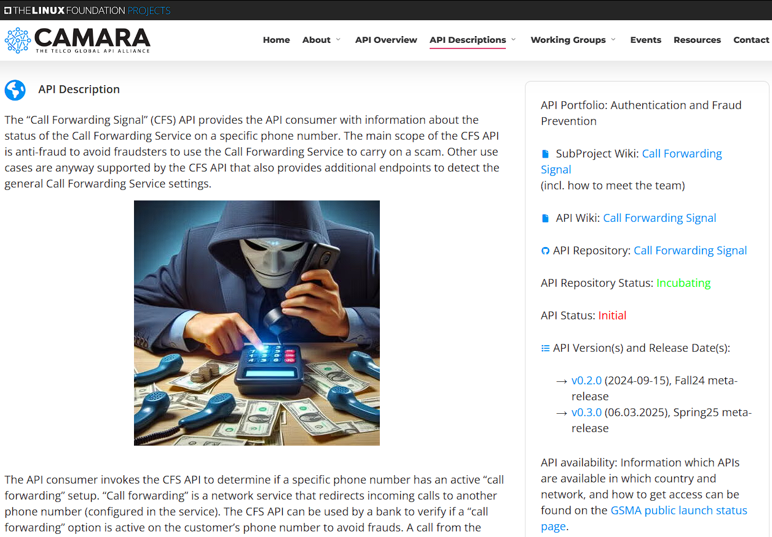
API Descriptions
API description
Use Cases
Benefits
Links to
  Sub Project (contacts)
  API Wiki
  API repository
  API version(s)
  GSMA public launch status

Slide 25
How CAMARA Works
Governing Board
Independent Sandbox
Strategy, financials, outreach
EUC
Drives APIs in early development
End User Council – Demands / Requirements
Sub Project
TSC
Drives one or more (mature) APIs
Technical guidelines and decisions
API Backlog
Common-
alities
Identity and Consent Management
Marketing / Outreach
Release Management
Maintains the API Backlog for CAMARA
Guidelines and assets mandatory for all CAMARA Sub Projects
Provides solutions to capture, store and manage user consent
Plans and performs marketing activities for CAMARA
Guidelines and assets for Release Management in CAMARA

Slide 26


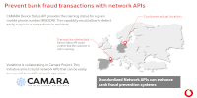
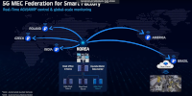
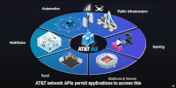

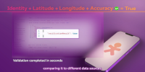







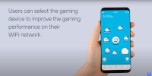





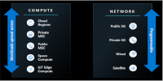
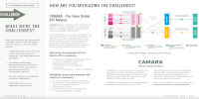


CAMARA / Open Gateway
API Showcases
https://camaraproject.org/resources/

Slide 27
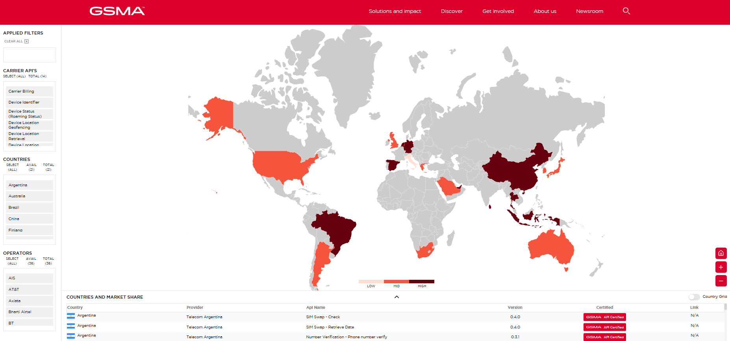
CAMARA / Open Gateway
API public launch status
https://open-gateway.gsma.com/

Slide 28
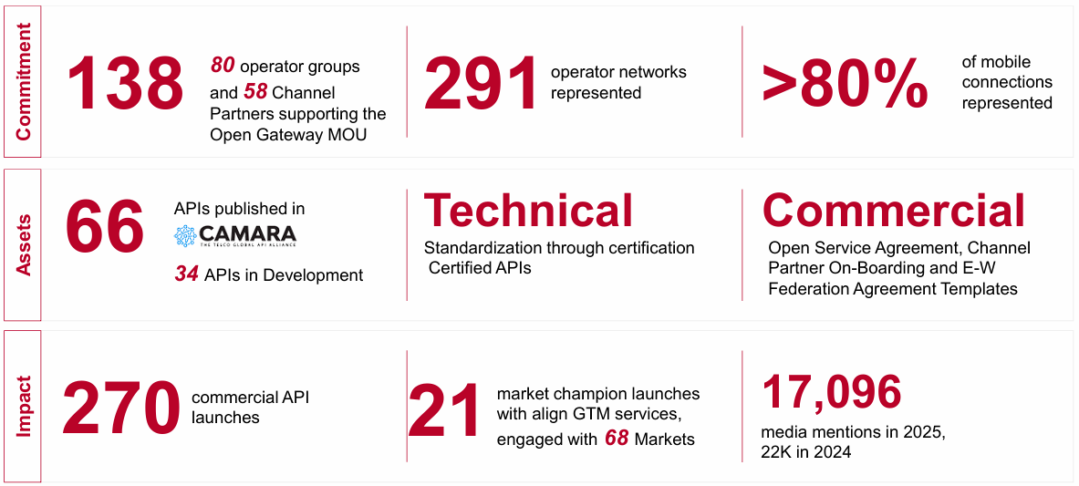
CAMARA / Open Gateway
API public launch status

Slide 29
5G network capabilities
Introduction
Telco network capabilities are functions partly available already in 4G but new and much more powerful in the 5G network. These functions enable to get information out of the network but also to configure the network.
The on-demand, secure and controlled exposure of these capabilities pave the way for transforming operator networks into service enablement platforms, facilitating the application-to-network integration, which will be key to deliver enhanced and service-tailored customer experience in the 5G era.

Slide 30






5G network capabilities
Introduction
Reachability and Location of UEs
Identify (last known) location of drone
# of UEs in geographic region
Traffic jam or Corona warning
# of UEs in slice, network congestion
Adapt resolution for video transmission
Quality on Demand / Traffic influence
Enable augmented reality
Wake up UEs
Support low energy IoT devices
Block UEs in geographic region
Crisis management

Slide 31





Potential Business Use Cases
Authentication and Fraud Prevention
Location Services
Communication Quality
Device Information
Computing Services
Network APIs offer the opportunity
For customers to optimize their use cases and applications
For operators to monetize their invest in 5G infrastructure
It’s a win-win!
Secure Auth
Fraud Prevention
Location Verification
Location Retrieval
Location Geofencing
Safeguarding of Transactions
Remote Control
AR/VR/XR
Gaming
Proactive User Information
Edge Application hosting
Latency optimization
Number Verify, Sim Swap, etc.
Location APIs
Quality on Demand
Device Data Volume
Simple Edge Discovery

Slide 32

Anti Fraud APIs

Slide 33


The API ecosystem – Current status and challenges
Show the figures (successful revenues) - GSMA
Customer
Find balance between regulation/data privacy and usability for the markets - GSMA
Prepare all layers for (agentic) AI –
Channel Partners, GSMA, CAMARA
First UC possible
Next
slide
Channel Partner / API & Product Layer
Introduce products - Channel Partners
  Change communication (solve customer problems instead of expose capabilities)
  Design and develop products following customer need, considering alternative (non-telco) solutions and attractive pricing
Aggregation Layer
API Exposure Layer
Push market coverage and communicate it - GSMA
Close gaps at operators - Operators
CPaaS capabilities
NW capabilities
Enable Consent API for multi-API one-step consent independent of API flows - CAMARA

Slide 34
The API ecosystem –
Prepare for agentic AI
CAMARA should provide context for MCP servers, esp. scopes and purposes, user consent requirements
CAMARA should adjust security guidelines and API design guidelines
CAMARA should provide authoritative MCP function definitions versioned in lockstep with corresponding CAMARA API definitions
GSMA/OGW should add MCP servers to technical standards, launch map, certification
Operators and Aggregators should expose MCP servers in parallel to APIs
Channel partners and Customers should use LLMs/MCP hosts/MCP clients in parallel to products. Channel partners also can expose MCP servers to customers.
Customer
MCP host&client
MCP server *
Channel Partner / API & Product Layer
MCP server *
Aggregation Layer
MCP server *
API Exposure Layer
CPaaS capabilities
NW capabilities
* MCP server can sit in exposure layer (for single operator APIs), aggregation layer (for aggregated APIs) or Channel Partner layer. But aggregation only happens on API side, not on MCP side

Slide 35
The API ecosystem – Current status and challenges
Customer / LLM / AI Agents
CSP – Critical Success Point 2026
Channel Partner / Products & MCP Servers
Aggregators in each market
Aggregation Layer
API Exposure Layer
CPaaS capabilities
NW capabilities

Slide 36
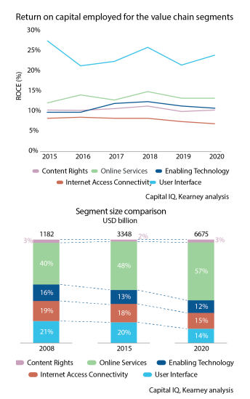
AI does not solve the telco dilemma
AI offers a low-hanging fruit for telcos to save cost and improve UX, e.g.
  Hotline automation (for customers and employees)
  Network automation up to autonomous networks
  …
For that reason telcos prioritize AI activities in the moment (sometimes at the expense of APIs)
But AI won’t solve the telco dilemma, APIs are key for that. You cannot build an AI agent / MCP server without a tool / API
AI gives a breather to the API teams, but it should be used to
  Prepare for (agentic) AI
  Close gaps

Slide 37

APIs and AI – The intersection
4 different scenarios:
AI used by developers inside operators for their daily work
AI used inside operators to develop better APIs (e.g. prediction)
AI used by operators as an additional portfolio (MaaS)
AI used as sales channel (agentic AI)

Slide 38

In Concert: Bridging AI Systems and
Network Infrastructure through MCP
To enable LLMs accessing network capabilities, APIs and a bridging protocol (MCP) is needed. Combining both AI developers can
  Deliver more intelligent, network context-aware services
  Reduce delivery complexity, accelerate time-to-market, expand global reach
  Enable AI models to make real-time, policy-compliant decisions that optimize UX and resource utilization
Example use cases are listed in the whitepaper

Slide 39
In Concert: Bridging AI Systems and
Network Infrastructure through MCP
No fundamental changes are required to either ecosystem
  Provide context for MCP servers, esp. scopes and purposes, user consent requirements
  Follow CAMARA security guidelines and API design guidelines (both need to be adjusted to AI)
  CAMARA may provide authoritative MCP function definitions versioned in lockstep with corresponding CAMARA API definitions
Details are documented in the whitepaper

Slide 40
Benefit for developers to use CAMARA APIs
1
Reduces friction for developers to access network information across telcos globally.
Additional revenue on existing assets, leveraging SDN and NFV capabilities
2
Increases usage and value of telco networks by providing easy access to network capabilities.
3
Enables developers to create new applications or improve existing ones with access to these capabilities.

Slide 41
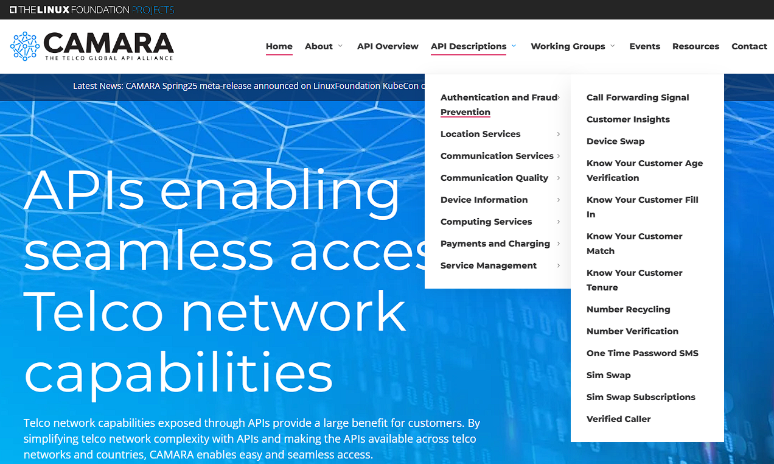
Developers Getting Started with CAMARA APIs

Slide 42
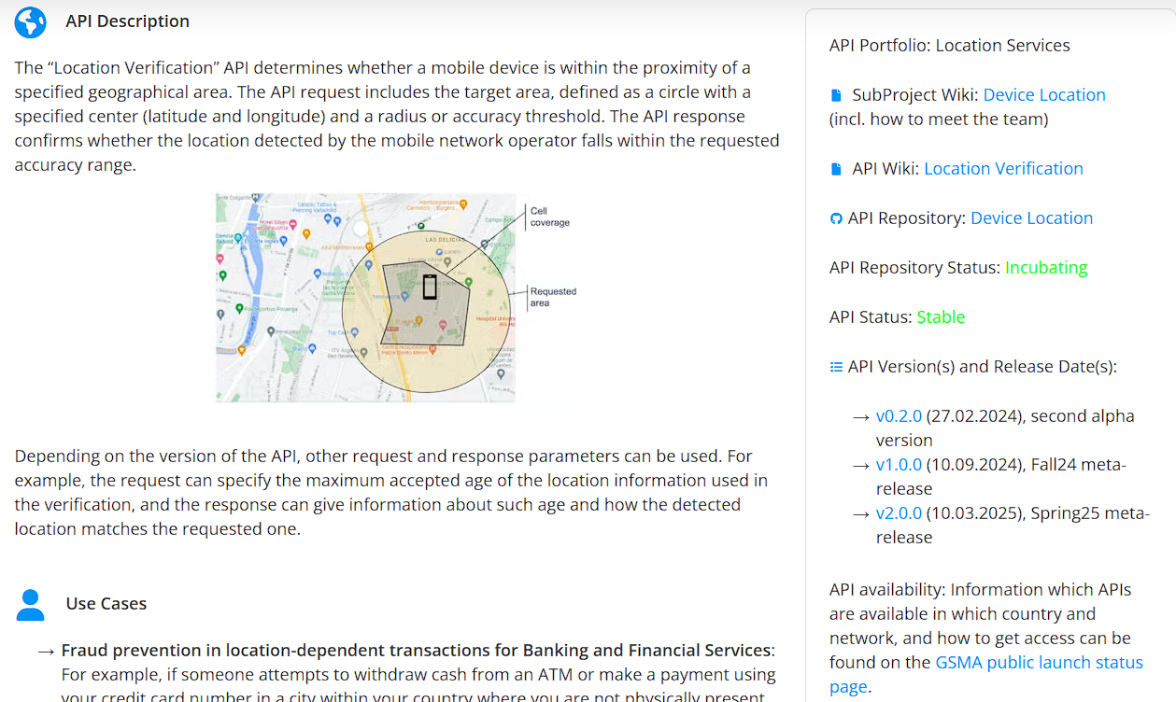
Developers Getting Started with CAMARA APIs

Slide 43
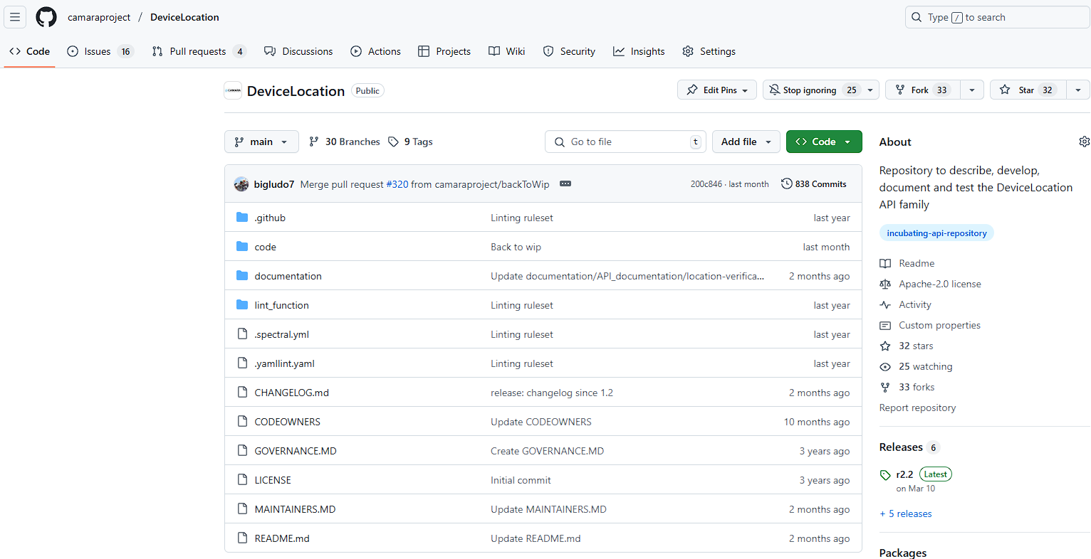
Developers Getting Started with CAMARA APIs

Slide 44
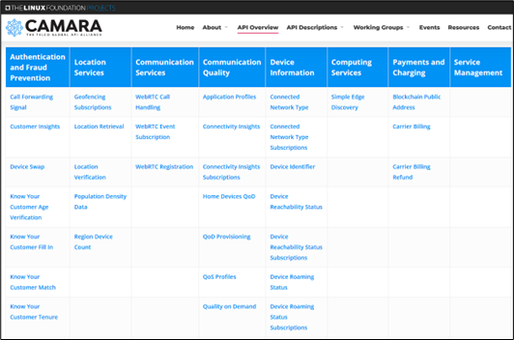
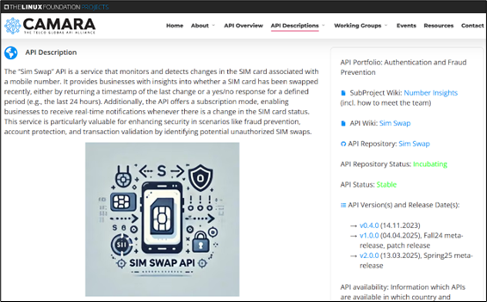
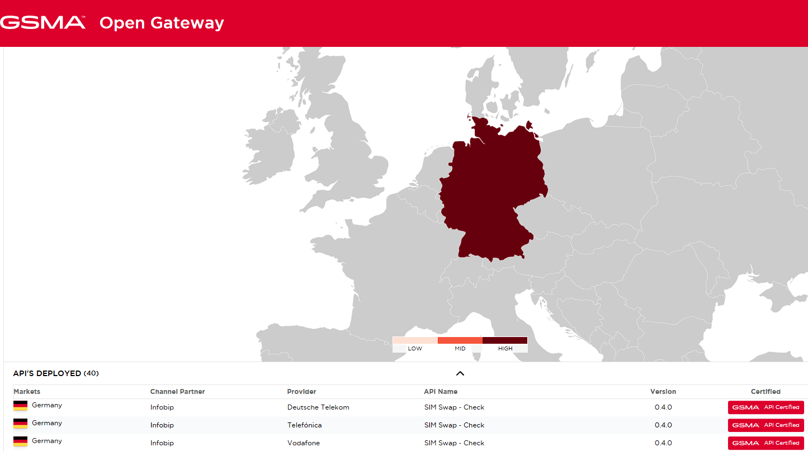
Developers Getting Started with CAMARA APIs
Integrate API call in own code, e.g. for Sim Swap:
Get API definition and documentation from https://camaraproject.org/api-overview/
(open&free!)
Get API availability from GSMA public launch status map (linked in API description)
Get API access e.g. from DT, Orange, Telefonica (linked in map)

Slide 45
Benefit for developers to work in CAMARA
As a typical Open Source Project CAMARA is driven by contribution!
People who contribute define priorities and drive the direction.
Working in CAMARA on API definitions, API documentations and API code (transformation functions) enables to
Bring in own demand and contribute a solution
Influence the definition of new APIs and API versions
Ensure that own requirements are considered
Provide code which can be used globally
Learn about CAMARA, Open Gateway and the Network API ecosystem
Get deep knowledge about the APIs
Become maintainer and TSC member to influence technical decisions in CAMARA

Slide 46
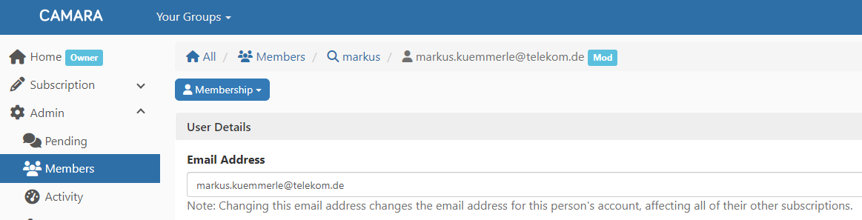
Joining CAMARA as Developer
To join the CAMARA mailing list send an (empy) email to all+subscribe@lists.camaraproject.org.
The CAMARA GitHub https://github.com/camaraproject can be accessed without any prerequisite. To create issues and start contributing to CAMARA you need a free GitHub account.

Slide 47
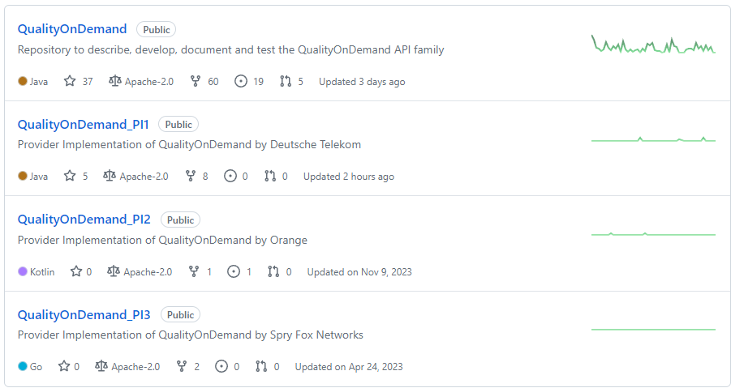
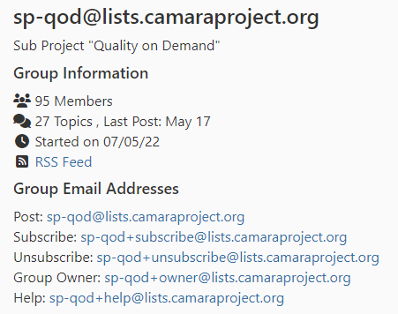
Joining CAMARA as Developer
Each API in CAMARA is developed in a separate repository under a Sub Project or as an Independent Sandbox with (example QoD):
A dedicated lead repository (containing API definition and API documentation)
0…n provider implementation repositories (containing API code)
A dedicated mailing list and meeting schedule to discuss progress/issues on the APIs

Slide 48
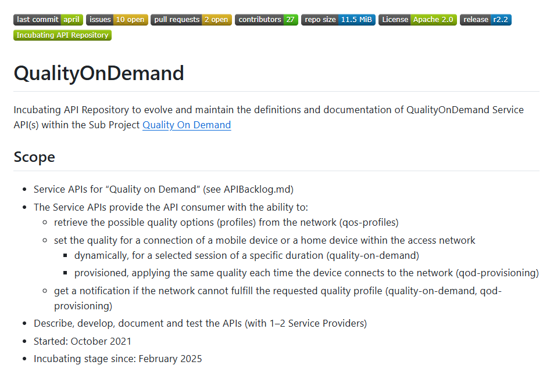
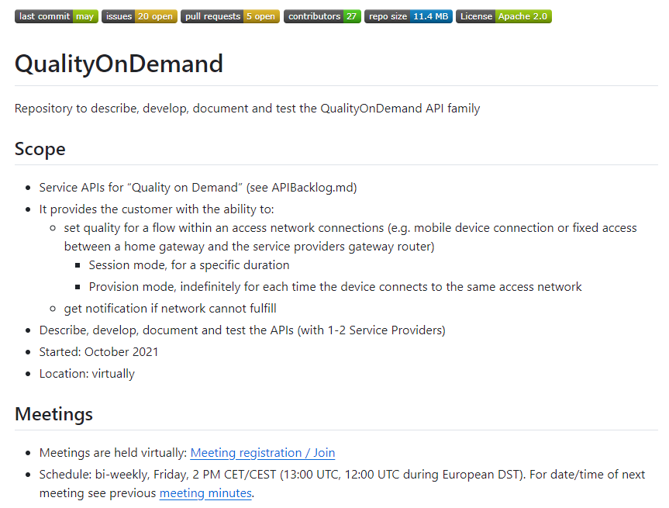
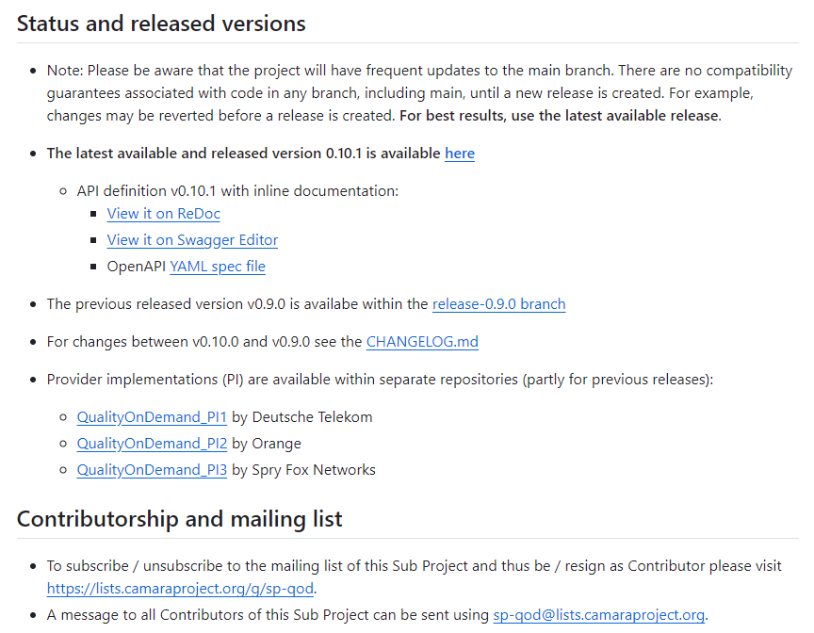
Joining a Sub Project as Developer
To join a Sub Project please have a look into its Readme.md (example Quality on Demand):

Slide 49
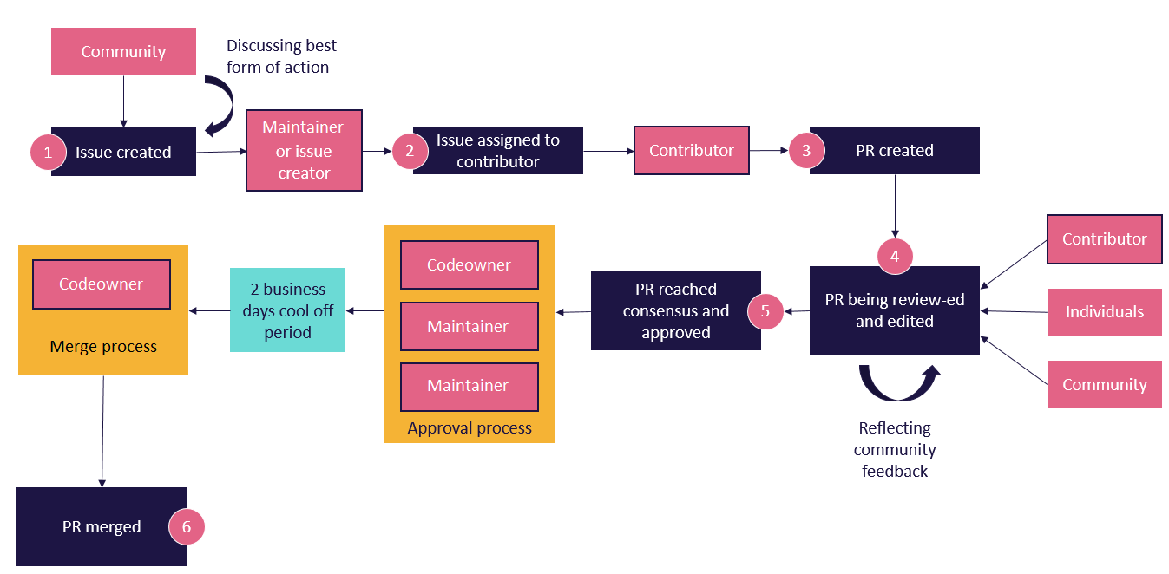
Contributing to CAMARA
In the Project the “Fork and pull model” is used. Changes and contributions to CAMARA shall follow this process:
thttps://github.com/camaraproject/Governance/blob/main/ProjectStructureAndRoles.md

Slide 50

Benefit for operators to implement
CAMARA APIs in their networks
Operators have made high investments in
Spectrum licenses
Infrastructure (cell towers, fibre)
Operators haven‘t been successful in
Increasing prices for connectivity contracts
CAMARA APIs open opportunities
To monetize the high investments
To improve customer experience
For market positioning

Slide 51


What have operators to do to implement Network APIs?
Implement CAMARA APIs based on the network capabilities
Implement an exposure infrastructure,
with TMForum Operate APIs
Define commercial products
Sell it

Slide 52






What have operators to do to implement Network APIs?
API Customer
Possible API workflows
Catalog published from SEP to portals
Customer onboarding to SEP
Customer orders API, SEP sends credentials to access API
If necessary SEP requests user consent for API. Capacity management is done. Customer uses API. SEP performs metering and rating.
SEP initates billing for wholesale and retail
Customer offboarding
Wholesale
(Aggregators, Hyperscaler, SIs, ISVs)
Telco Portal
(Enterprise Customers)
Service Exposure Platform (SEP)
Internal API-Gateways
Network / Backend
Mobile Network Capabilities
Fixed Line Network Capabilities
Telco IT Capabilities
Cloud Capabilities
Service API
IT API
Operate API

Slide 53
Benefit for operators to work in CAMARA
Networking and Partnerships
Access to a growing global network of industry leaders
Technological Advancements
Knowledge Exchange
Shared Resources
Collaborative projects often lead to cost savings through shared resources and reduced duplication of efforts
Benefit from the collective research efforts
Collaborative Innovation
Industry Collaboration
Standardization: contribute to development of industry standards, ensuring interoperability and consistency across networks and services
Bring in your requirements!

Slide 54
Benefit for operators to work in CAMARA
Why Join CAMARA as a sponsor /member?
Seat on the Governing Board to influence CAMARA strategy
Elevate your Brand
Signal Support & Commitment to open API development
Discounts on Linux Foundation events & programs
Help ensure the Project continues to provide needed governance & infrastructure
Platform to showcase thought leadership

Slide 55
Operators Getting Started with CAMARA
Individuals and organizations who are application developers / API consumers (e.g. enterprises and startups), aggregators, cloud operators, telco operators, network equipment vendors, system integrators, and software vendors are welcome to join CAMARA.
For organizations:
If you are interested to show your logo on the CAMARA website as “Participating Organization” send a .SVG version of it to adm@lists.camaraproject.org. Participation is free, without any fees or obligations.
If you would like to become a CAMARA sponsor please don’t hesitate to use the enrollment link. The cost is depending on the kind of membership and the number of employees.
Associate Members of The Linux Foundation can also join as "Associating organization" for free, without any fees or obligations.

Slide 56
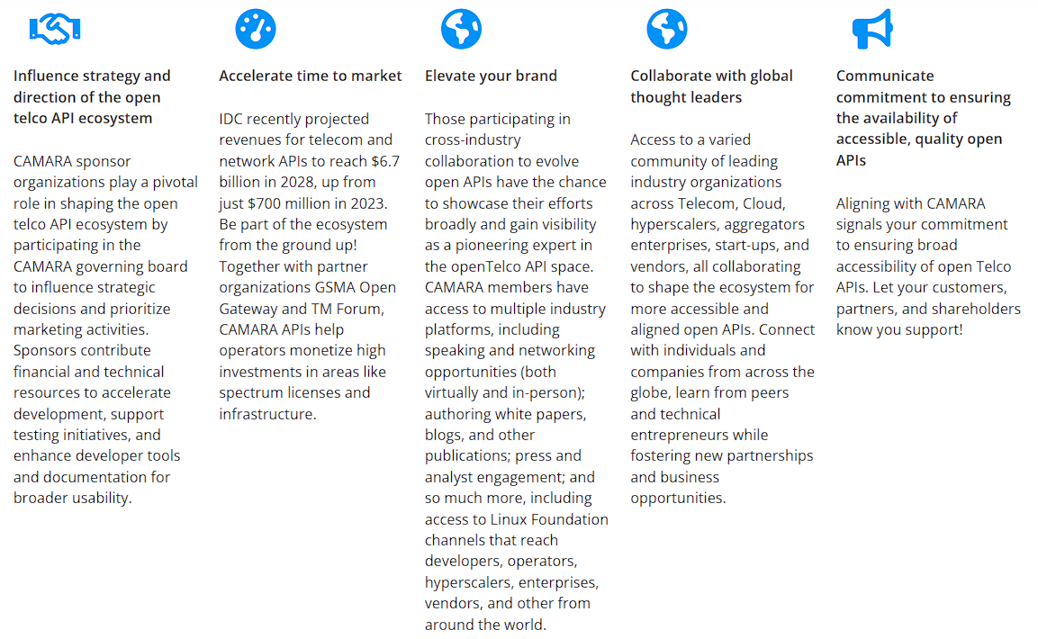
Operators Getting Started with CAMARA
Why Organizations Join CAMARA?
Aside from having a seat at the collaborative table to shape the future of the open telco API ecosystem, organizations join CAMARA as a sponsoring member to:

Slide 57
CAMARA Membership Benefits
Overview
Collaborate for Impact
Drive Business Growth
Exclusive Access & Privileges
Collaborate for Projects
Shape the future: Influence marketing & event strategies
Lead the way: Access thought leadership opportunities
Exclusive events: Attend and plan member-only events
Collaboration with major players: Work alongside telcos, hyperscalers, and developers in a neutral, open-source environment
Visibility: Feature in research reports and the speakers’ bureau
Amplify your brand: Get broad exposure across CAMARA and ecosystem
Lead the industry: Secure a seat on the Governing Board
Drive global interoperability: Help ensure your organization's needs are considered in the push toward standardized, interoperable APIs across networks and regions
Early access to new APIs and features: Stay ahead of the market by testing and deploying APIs before general release
Strategic planning: Shape long-term goals on the Strategic Planning Committee
Expand ecosystem reach: Position your company at the center of a global developer and network provider community
Priority input on policies and licensing: Help define the rules and frameworks that govern CAMARA's operations and contributions
Strategic seats: Join Outreach, Governing Board, and other committees as a voting member
Shape API development: Gain a voice in defining, prioritizing, and evolving the CAMARA APIs that align with GSMA Open Gateway and network operator needs
Member discounts: Save on LF events, training, and more
Access to roadmap discussions: Participate in strategic planning and early access to upcoming features and initiatives
Engage with the community: Participate in TSC calls, Zulip channels, and other community forums
Collaborate on code projects: Contribute to and innovate within various API Working Groups and Sub Projects
Workstream participation: Get involved in workstreams to drive development forward
Free to All Organizations
(Code Involvement)
Member-Only Benefits
(Non-Code Focus: Collaboration & Growth)

Slide 58
Top 10 Reasons to Join as a Member
Influence Global API Standards: Shape the development of open, telco-exposed APIs aligned with the GSMA Open Gateway initiative - ensuring your business needs are reflected in global standards.
Accelerate Service Innovation: Leverage standardized APIs to unlock network capabilities (e.g., QoD, device location, slicing) and build differentiated digital services faster.
Collaborate with Industry Leaders: Develop personal relationships with thought leaders (including executives, architects, program manager, engineers, and more) from a global community of telecom operators, hyperscalers, and aggregators, and enterprises all working together to bridge networks and applications through open source.
Set the Open Telco API Development Strategy: Participate in building an ecosystem that makes it easier for developers to consume network capabilities - growing adoption and monetization of your services.
Gain Early Access to APIs and Roadmaps: Stay ahead of the market with insider access to early-stage APIs, technical roadmaps, and experimental features.

Slide 59
Top 10 Reasons to Join as a Member
Expand Business Opportunities: Enable cross-operator, cross-border deployment of your services by building once and scaling globally with consistent APIs.
Boost Visibility and Brand Recognition: Access co-marketing opportunities, including event participation, case studies, webinars, and blog posts - highlighting your leadership in telco innovation.
Participate in Governance and Leadership: A voting membership on the CAMARA Governing Board enables you to Influence the direction of the open telco API ecosystem align with your business strategy.
Align with Other Open Source Projects and Industry Initiatives: Collaborate easily and directly with other Linux Foundation projects such as LF Networking, CNCF, Sylva and more, as well as major industry bodies like GSMA, TMForum, MEF, CPaaSaa (and more) - position your organization at the center of the open telco APi movement.
Elevate Your Organization’s Industry Perception within the Telco API Ecosystem: Joining the CAMARA Board sends the message that you are a technology leader within a technology on the precipice of unlocking new monetization opportunities. Your absence could be perceived as reluctance to adopt this new technology disruption.

Slide 60
CAMARA
Where are we going next…
1
Additional APIs and roadmap sync across CSPs, Aggregators and Hyperscalers
2
API lifecycle management consistency,
Documentation of API versioning and availability globally
3
Drive API Adoption (application developers and operators)

Slide 61

CAMARA
Contacts
Individuals and organizations from application developers / API consumers (e.g. enterprises and startups), aggregators, cloud operators, telco operators, network equipment vendors, system integrators, and software vendors are welcome to join CAMARA.
To access CAMARA technical resources like API definitions, API specifications or API code just visit the CAMARA GitHub. All resources are reachable without any prerequisite. To create issues and start contributing to CAMARA you need a free GitHub account without any further prerequisite. This participation is free, without any fees or obligation to work.
If you are interested to be included in the CAMARA communication, please subscribe to all+subscribe@lists.camaraproject.org. You may unsubscribe from CAMARA and these communications at any time. Participation is free.
If you are interested to show your logo on the CAMARA website as “Participating Organization” you can send it to adm@lists.camaraproject.org. Participation is also free.
If you would like to join as CAMARA sponsor or associating organization, please don’t hesitate to use the enrollment link https://enrollment.lfx.linuxfoundation.org/?project=camarafund. Cost is depending on the kind of membership and the number of employees.

Slide 62


